Slide 1
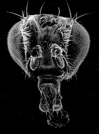
An Instructive Role for the Unconserved Groucho Central Region in Transcription Factor Gradient Interpretation
Wiam Turki-Judeh
Courey Lab
Dissertation Defense
April 29, 2011
Notes:
Need to study embryo patterning (who represses what)
Refresh on recombineering

Slide 2
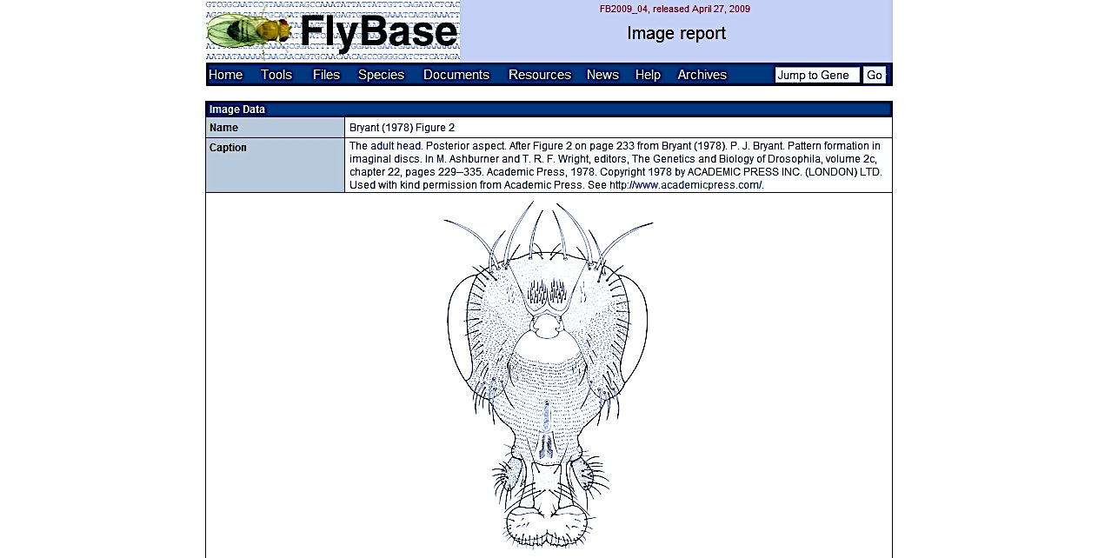
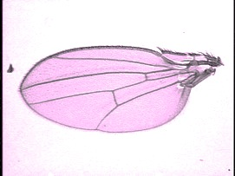
The regulation of transcription plays an important role in development
Notes:
Drosophila development depends in large part upon the spatial and temporal regulation of transcription, a process that requires combinatorial interactions between activators…blah blah..

Slide 3
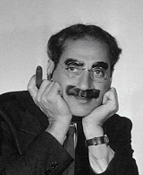
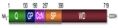
Groucho (Gro) Groucho Marx
groucho¹
groucho^{Marx}
groucho mutant results in extra supraorbital bristles
Gro
R
A
OFF
CRM

Slide 4
Gro mediates repression via interaction with DNA-bound repressor
Gro
TF
TF
Notes:
Groucho mediates long-range repression. The idea of long-range repression can be demonstrated in the following diagram. A transcription factor binds an CRM leading to a specific spatial expression pattern. An independent transcription factor binds to another enhancer element, at a distance of greater than 1 kb, and leads to a different specific spatial expression pattern. If Gro is recruited by one of these transcription factors, it can lead to the repression of all enhancer elements driving expression of the gene. This is in contrast to short-range repressors that mediate repression of single enhancer elements over a few hundred bps.

Slide 5
Gro mediates repression via interaction with DNA-bound repressor
Gro
TF
TF

Slide 6
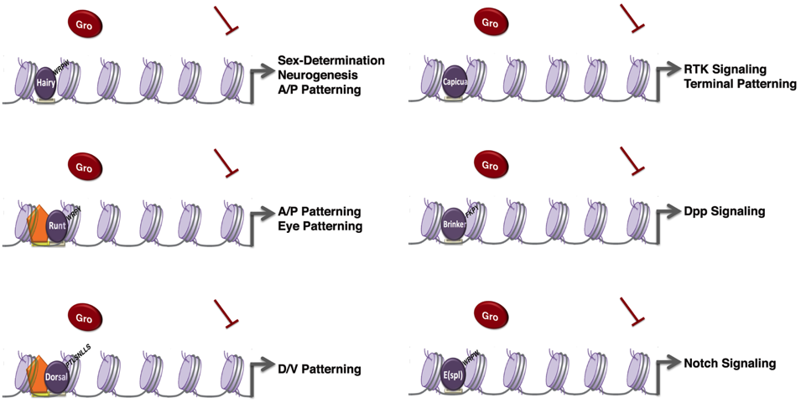
Groucho is a pleiotropic transcriptional regulator in Drosophila Development

Slide 7
Interpretation of transcription factor gradients: an active role for Gro
Transcription factor gradient
Concentration of Gro-dependent repressor (Dorsal, Brk, Cic, etc.)
Zone of expression
Threshold concentration for repression (low Groucho)
Zone of expression
Threshold concentration for repression (high Groucho)
Developmental axis
What determines the height of the threshold?
Affinity of the repressor for its binding site
Gro activity level

Slide 8
Dorsal
Lowest Nuclear Dl Concentration
dpp, zen
Groucho
Groucho
Embryo
Cross-Section
sna
Highest Nuclear Dl Concentration
Ventral

Slide 9
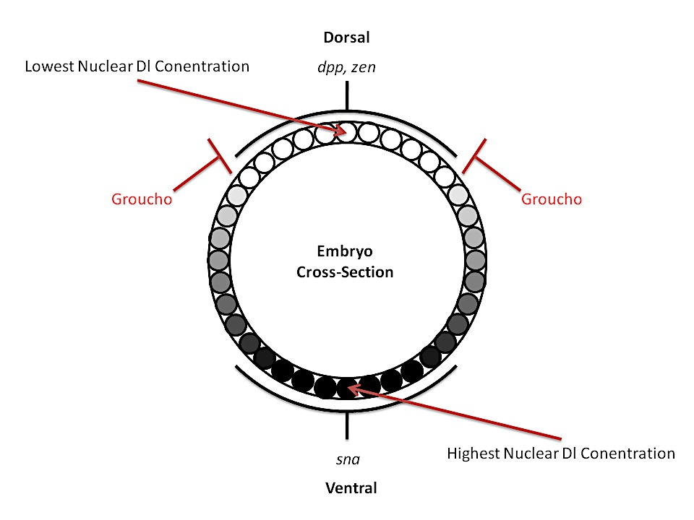
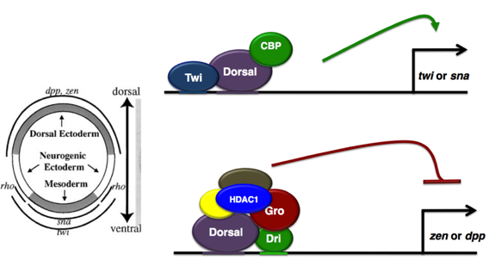
Gro plays key roles during embryonic development
Dorsal/Ventral Patterning in the embryo

Slide 10
Gro/TLE protein family
Mammals
72%
11%
31%
25%
89%
Myogenesis, Hematopoiesis, Apoptosis, Neurogenesis, Eye development
Neural tube formation, Osteogenesis
Placental and Adipose Development
B-cell lineage, CNS development
Notes:
The discovery of Gro family members in many different species provides increasing evidence that Gro proteins play widespread roles during development.

Slide 11
Gro/TLE protein family
Xenopus
69%
13%
36%
30%
89%
CNS development, Somitogenesis, Axis formation, Wg/Wnt signaling
C. elegans
26%
8%
58%
Left/Right patterning, Neurogenesis, Sex-specific apoptosis, Male ray development
Notes:
The discovery of Gro family members in many different species provides increasing evidence that Gro proteins play widespread roles during development.

Slide 12
Structure/Function relationships in Gro
Binding to hypoacetylated histone tails
Although the functions of the Q and WD domain have been extensively studied, the internal domains are not well characterized.
Sequencing of a large set of lethal Gro/TLE point mutant alleles revealed mutations that map to the Q and WD-repeat, demonstrating the functional importance of these two domain (Jennings et al, 2006 and 2008).
None of the known point mutations map to the GP, CcN, or SP domains, suggesting that these domains represent very small mutagenic targets or are functionally expendable.
Self-association
Repressor binding
Rpd3 binding
NLS,
Regulatory region
Down-Regulation region
Repressor binding (WRPW, eh1)
Notes:
Although the functions of the Q and WD-repeat domains have been extensively studied, the internal domains are not well characterized. Sequencing of a large set of lethal Gro/TLE point mutant alleles revealed a large number of mutations that map to the WD-repeat domain and a smaller number that map to the Q domain, demonstrating the functional importance of these two domain (Jennings et al, 2006; Jennings et al, 2008). However, none of the known point mutations map to the GP, CcN, or SP domains, suggesting that these domains represent very small mutagenic targets or are functionally expendable (Jennings et al, 2008).

Slide 13
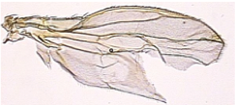
Goal is to elucidate the mechanism of Gro-mediated repression and the role of Gro in pattern formation by constructing and analyzing multiple Gro deletion mutants lacking one or more of the central domains.

Slide 14
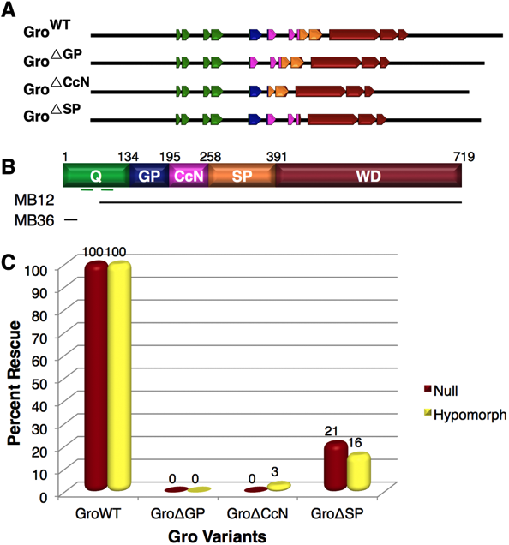
1. Self-association
Chen et al, 1998
Double point mutations in AH1 and AH2 (in Q domain) abolish Gro repressive activity in S2 cells and wing disc, but not in the target genes assayed in the embryo (Chen et al, 1998, Song et al, 2004, Jennings et al, 2008).
Drosophila Gro found at the promoter, at +1kb and +2kb, and at a reduced level at +4kb (Martinez et al, 2008).
Murine Gro/TLE is able to bind nucleosome arrays assembled in vitro and direct the formation of nucleosome aggregates. A Gro/TLE N-terminal truncation that eliminated self-association did not direct nucleosome aggregation, nor did it decrease promoter occupancy by TATA binding protein (TBP) and RNA polymerase II (Sekiya et al, 2007)
Notes:
murine Gro/TLE is able to bind nucleosome arrays assembled in vitro and direct the formation of nucleosome aggregates (Sekiya & Zaret, 2007). A Gro/TLE N-terminal truncation that eliminated self-association did not direct nucleosome aggregation, nor did it decrease promoter occupancy by TATA binding protein (TBP) and RNA polymerase II (Sekiya & Zaret, 2007).

Slide 15
2. Chromatin association
Gro found to directly bind histones (H3, H3, H2A, H2B) (Flores et al, 2000)
Gro/TLE alone is sufficient to preferentially bind nucleosomal arrays in a histone-tail-dependent manner in vitro, and condense the chromatin (Sekiya et al, 2007)
Upon recruitment of Gro/TLE to the template by a repressor. Formation of a closed chromatin region spanning three to four nucleosomes occurs upon Gro/TLE recruitment to the template by repressor.

Slide 16
3. Interaction with histone deacetylation
HDAC
HDAC
HDAC
HDAC
HDAC
Gro
Gro
Gro
Gro
Repressor
Gro
Ac
Ac
Ac
Ac
Ac
Ac
Ac
Ac
Ac
Ac
Ac
Ac
Ac
Ac
Ac
Ac
silencer
TSS
Synergistic genetic interaction between gro and rpd3 (Chen et al, 1999, Mannervik et al, 1999).
Gro found to directly interact with Rpd3/HDAC1 via the GP domain (H3, H3, H2A, H2B) (Chen et al, 1999, Brantjes et al, 2001).
Wildtype Rpd3, but not a catalytically inactive mutant, was found to stimulate repression of a Gal UAS-containing reporter by a Gal4-Gro fusion protein, as well as HDAC inhibitors (Chen et al, 1999).

Slide 17
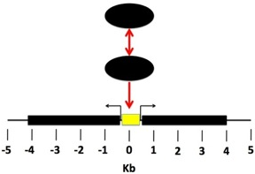
HDAC-dependent increase in nucleosome density at Gro targets
A
Groucho
D
Brinker
Repressor
white
VgQ
lacZ
B
E
C
F
ChIP-qPCR on wing discs Winkler et al, 2010

Slide 18
4. Interaction with the core transcriptional machinery
Gro
Repressor
IIE
AES is found not only to bind AR, but is also able to inhibit transcriptional activation by AR in an vitro transcription system (Yu et al, 2001).
AES binds TFIIE, a component of the core machinery (Yu et al, 2001), which suggest a model in which, upon AES recruitment, looping of the template allows an interaction between AES and TFIIE, thereby blocking the function of the preinitiation complex (PIC).
Model challenged because AES unable to repress basal transcription.
Gro/TLE genetically interacted with MED1 and MED12, but interaction may be indirect because no proof if Mediator subunit mutations affect Gro/TLE mediated repression of target genes (Zhang et al, 2002).
Notes:
AES is found not only to bind AR, but is also able to inhibit transcriptional activation by AR in an vitro transcription system reconstituted from highly purified factors presumably devoid of histones. Furthermore, AES binds TFIIE, a component of the core machinery (Yu et al, 2001). These findings suggest a model in which, upon AES recruitment, looping of the template allows an interaction between AES and TFIIE, thereby blocking the function of the preinitiation complex (Courey & Jia, 2001). However, this model is challenged by the observation that AES is unable to repress basal transcription (Yu et al, 2001)

Slide 19
5. Masking of activation domains
JNK
JNK
Gro
Pax2
Pax2 target genes
Phosphorylation of the Pax2 activation domain by c-jun N-terminal kinase (JNK) potentiates Pax2 activation of target genes.
Gro binding inhibits Pax2 phosphorylation by JNK (Cai et al, 2003).
Gro binding to the activator can either block the activation domain by directly binding to that region or may cause a conformational change, and hence ”mask” the activation domain.

Slide 20
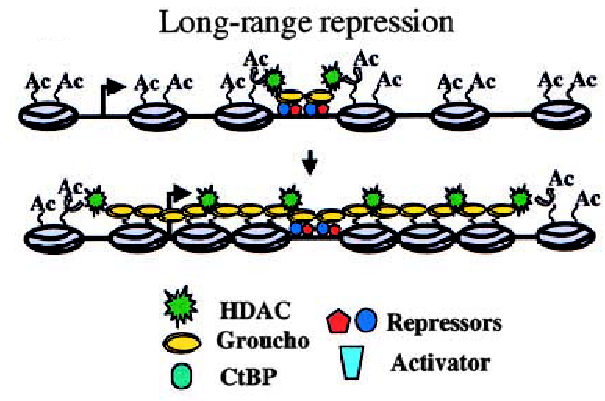
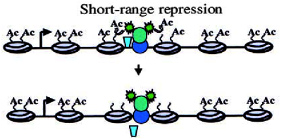
Long versus short-range transcriptional repression
Sloppy-paired 1 (Androli et al, 2004)
Knirps (Payankaulam and Arnosti, 2009)
Courey and Jia, 2001

Slide 21
1. Strength of the Gro/TLE interaction domain
Dorsal
The dual functionality of Lozenge and Dorsal relies on the fact that these two factors have an intrinsically low affinity for Gro, and require the assistance auxiliary proteins to create a high affinity platform for Gro/TLE recruitment.
Runt family member Lozenge

Slide 22
2. Competition with coactivators for repressor partners
Wg/Wnt OFF
Wg/Wnt ON
Gro
^{Β-catenin}
Gro
^{β-catenin}
Tcf/Lef
OFF
Tcf/Lef
ON
Wg/Wnt response genes
Wg/Wnt response genes
β-catenin and Gro/TLE bind to overlapping region in Tcf/Lef (Weiss and Daniels, 2005).

Slide 23
3. Posttranslational modification
Poly(ADP-ribosy)lation (Ju et al, 2004)
Phosphorylation (Choi et al, 2005, Hasson et al, 2005, Nuthall et al, 2002, Nuthall 2004)

Slide 24
4. Interactions with AES/Grg5
AES/Grg5 interacts with longer Gro/TLE members, which would sequester it into an inactive complex.
Interact with the DNA binding repressor via the Q domain (Brantjes et al, 2001).
AES/Grg5 cannot interact with Rpd3/HDAC1 (Brantjes et al, 2001).
Gro
AES
Gro
Gro
Inactive complex
Gro
AES
Binds to repressor
ON
Tcf/Lef
OFF
Tcf/Lef target genes
Notes:
this naturally occurring truncated form of Gro modulate Gro/TLE mediated repression? A possible answer to this question is suggested by a study showing that AES cannot bind to Rpd3/HDAC1 even though a truncated form of Gro/TLE containing just the Q and GP domains is able to bind this histone deacetylase. This suggests that the GP domain in AES may not have full functionality (Brantjes et al, 2001). Based on these results, it was postulated that the Q domain-mediated interaction between Gro/TLE and AES might disrupt the function of the Gro/TLE homo-oligomer (Brantjes et al, 2001). In addition, since the Q domain of Gro/TLE interacts with some repressor proteins, including Tcf/Lef, it was hypothesized that AES antagonized Gro/TLE-mediated repression by interacting directly with repressors (Brantjes et al, 2001; Mallo et al, 1993). In support of this view, AES is able to interact with Tcf/Lef (Brantjes et al, 2001).

Slide 25
Outline
1: To evaluate the in vivo function of the Gro central region through the overexpression of central domain deletion variants in the wing and the embryo
2: To evaluate the roles of the Gro central domains in subcellular localization.
3: To develop Gro genomic rescue constructs and employ them to determine the roles of the central domains in normal development.
4: To Identify proteins that interact with the individual Gro regions.

Slide 26
1: GAIN OF FUNCTION
To evaluate the in vivo function of the Gro central region through the overexpression of central domain deletion variants in the wing and the embryo.
Pattern formation phenotypic defects
Expression changes of target genes

Slide 27
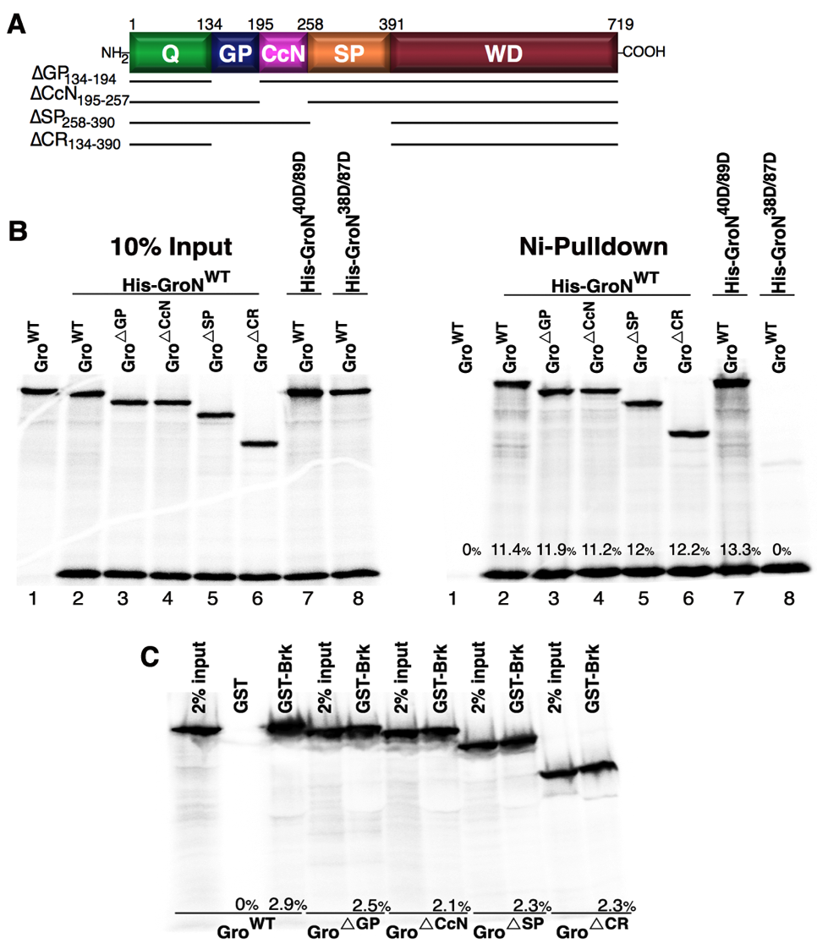
Generating Gro Deletion Variants

Slide 28
Gro deletion variants do not impede self-association

Slide 29
Gro deletion variants do not impede binding to the Brk repressor

Slide 30
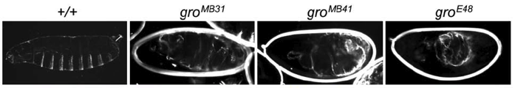
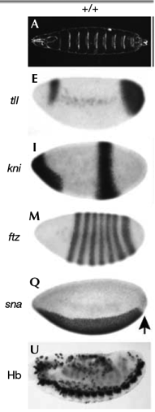
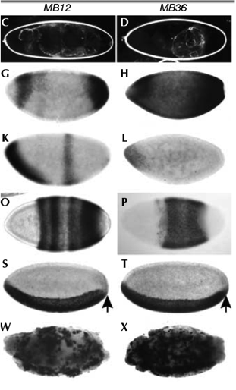
Groucho roles during embryonic development
Gro loss of function
Pic from Jennings et al., 2006
Gro has many known targets in the embryo
But no studies done on maternal effects of Gro overexpression in embryos
Pic from Jennings et al., 2008
Notes:
tailless (tll ) expression is restricted to the ends of
wild-type embryos by the Gro-dependent repressor Capicua (Cic),
thereby allowing expression of knirps (kni ) and Kru¨ppel (Kr) in acentral domain (

Slide 31
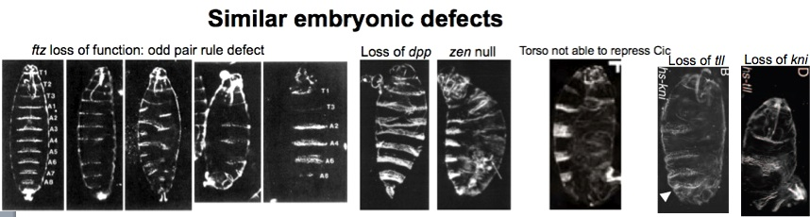
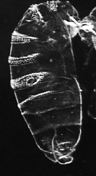
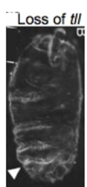
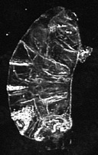
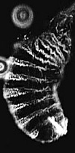
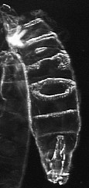
Gro^{WT} overexpression and embryonic development
zen null
Mat-Gal4
Loss of dpp
Arm-Gal4
Loss of tll
Mat-Gal4
Jazwinska et al., 1999
Moran et al., 2006
Cai et al., 1999
Loss of ftz
Mat-Gal4
Zhao et al., 1993
Notes:
COMPARE WT OE TO LOSS OF TARGET GENES. MAKE SURE TO ADD ACT-GAL4 PHENOTYPES

Slide 32
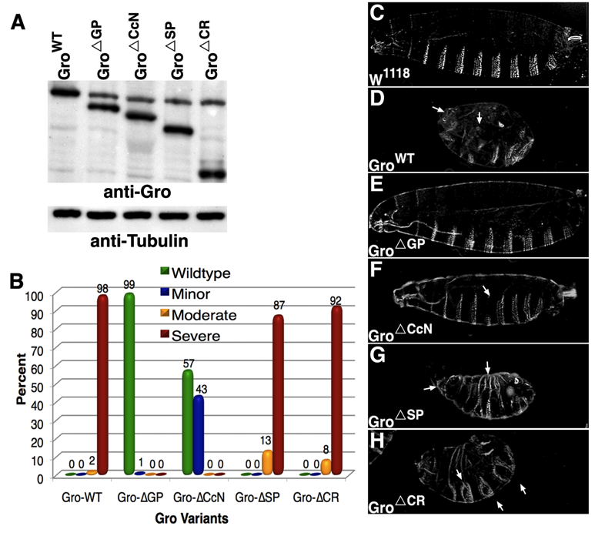


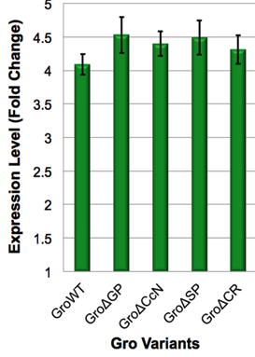
Cuticle phenotypes resulting from overexpression of Gro variants
Notes:
COMPARE WT OE TO LOSS OF TARGET GENES. MAKE SURE TO ADD ACT-GAL4 PHENOTYPES

Slide 33
Do Gro deletion variants affect transcript levels and spatial patterning in the embryo?

Slide 34
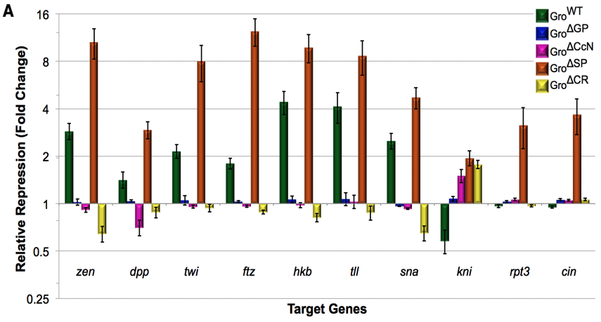
qRT-PCR reveals roles for the central domains in Gro-mediated repression of embryonic target genes
Repression
Activation
Embryos were collected from F1 females from 0-3 hours
cDNA levels were normalized to RpL32 and fold repression was then determined by dividing these values into the RpL32 normalized levels from the cross with the w^{1118.}
Notes:
COMPARE WT OE TO LOSS OF TARGET GENES. MAKE SURE TO ADD ACT-GAL4 PHENOTYPES

Slide 35
Interpretation of transcription factor gradients: an active role for Gro
Transcription factor gradient
Concentration of Gro-dependent repressor (Dorsal, Brk, Cic, etc.)
Zone of expression
Threshold concentration for repression (low Groucho)
Zone of expression
Threshold concentration for repression (high Groucho)
Developmental axis
What determines the height of the threshold?
Affinity of the repressor for its binding site
Gro activity level

Slide 36
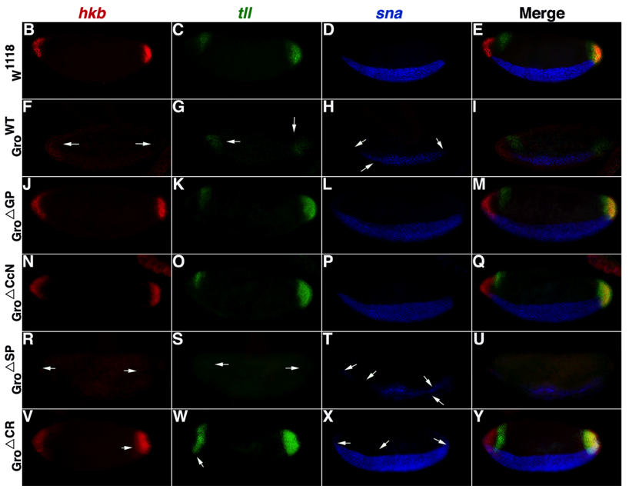
in situ reveals roles for the central domains in Gro-mediated repression of embryonic target genes
Notes:
COMPARE WT OE TO LOSS OF TARGET GENES. MAKE SURE TO ADD ACT-GAL4 PHENOTYPES

Slide 37
Wing development as a model to study Groucho mediated repression
Notes:
Dpp binds to a heteromeric type II/typeI transmembrane serine/theronine kinase receptor complex, encoded by thickveins and punt, triggering the phosphorylation of Mad, the drosophila receptor specific Smad. Then phosylated Mad associates with Medea and complex enters the nucleus to activate DPP responsive genes. And when Dpp signaling is active, Schnurri (Shn) switches off brinker expression

Slide 38
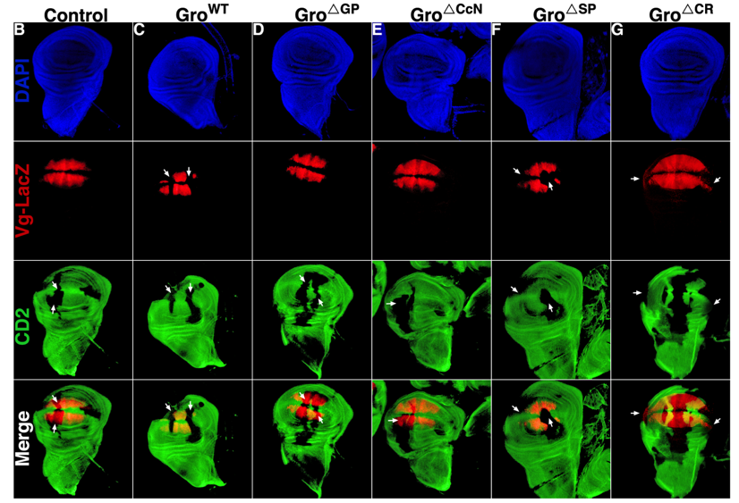
Overexpression clones reveal roles for central domains in Gro-mediated ectopic repression of a Brk target in the wing disc
Notes:
Dpp binds to a heteromeric type II/typeI transmembrane serine/theronine kinase receptor complex, encoded by thickveins and punt, triggering the phosphorylation of Mad, the drosophila receptor specific Smad. Then phosylated Mad associates with Medea and complex enters the nucleus to activate DPP responsive genes. And when Dpp signaling is active, Schnurri (Shn) switches off brinker expression

Slide 39
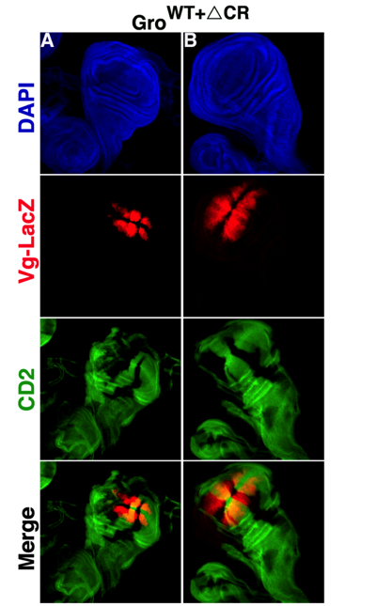
Gro^{ΔCR} blocks ectopic repression of a Brk target by Gro^{WT} in the wing disc
Notes:
Dpp binds to a heteromeric type II/typeI transmembrane serine/theronine kinase receptor complex, encoded by thickveins and punt, triggering the phosphorylation of Mad, the drosophila receptor specific Smad. Then phosylated Mad associates with Medea and complex enters the nucleus to activate DPP responsive genes. And when Dpp signaling is active, Schnurri (Shn) switches off brinker expression

Slide 40
2: Nuclear Localization Evaluate the roles of the Gro central domains in subcellular localization
Determine region responsible for nuclear localization of Gro
Identify sequence responsible for Gro nuclear localization through point mutations
Although the CcN region has a putative NLS, it has not yet been demonstrated that this domain is responsible for nuclear localization.

Slide 41
Subcellular localization of Gro central domain deletion variants
Notes:
COMPARE WT OE TO LOSS OF TARGET GENES. MAKE SURE TO ADD ACT-GAL4 PHENOTYPES

Slide 42
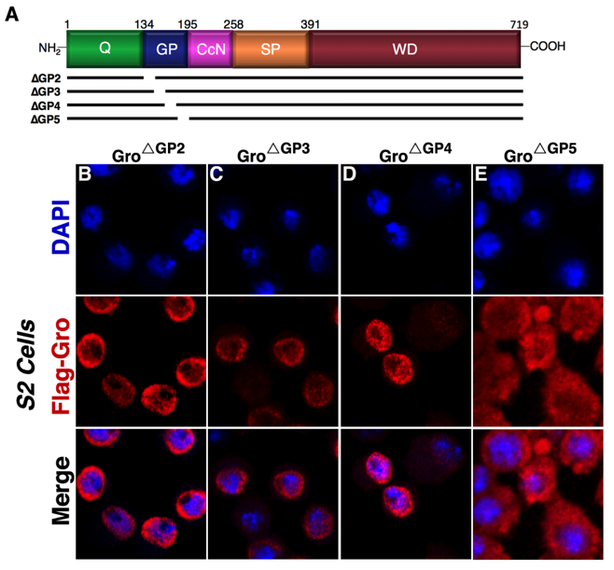
The GP domain and nuclear localization
GP5 = GLEGPAAAEERLRNS (No homology to known nuclear localization signals)

Slide 43
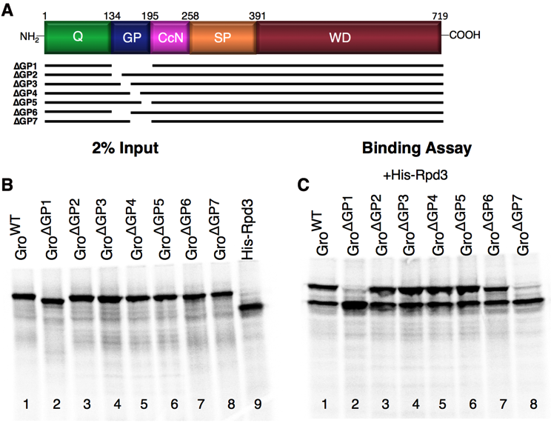
GP region responsible for Rpd3 recruitment overlaps with the region responsible for nuclear uptake

Slide 44
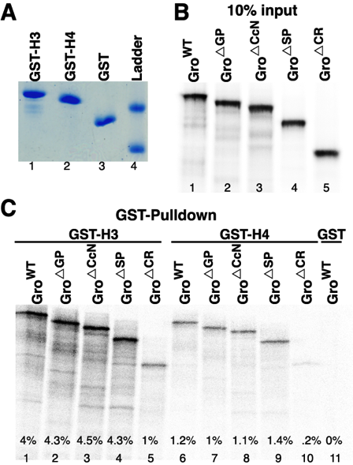
GST-pulldown assays reveal that individual central domain deletions do not affect binding of Gro to H3 or H4 tails

Slide 45
3: Loss of Function
While the overexpression experiments give important clues as to the function of the various Gro domains, they are not by themselves sufficient to determine the roles of these domains.
Develop Gro genomic rescue constructs and employ them to determine the roles of the central domains in normal development.

Slide 46

Rescue with gro deletion variants
♂
FRT gro***
x
{P[acman-gro]}^{22A}
♀
;
CyO
TM3,ser
{P[acman-gro]}^{22A}
FRT gro***
;
CyO
FRT gro***

Slide 47
Repressosome complex
Rpd3/HDAC1
Gro
MAPK or HIPK2
Repressor
Nucleus
Cytoplasm

Slide 48
Import protein
Gro
Gro^{ΔGP}
Overexpression in the embryo and wing display no phenotypes.
No affects on Gro target genes expression level observed when compared to W¹¹¹⁸ control.
Found completely cytoplasm, suggesting a role in Gro nuclear import.
This variant could not rescue in a gro null and hypomorph background, implying that the GP domain is ESSENTIAL for viability.
Critical for Gro function
Nucleus
Cytoplasm

Slide 49
Gro^{ΔCcN}
Overexpression in the embryo and wing display minor phenotypes, similar to weak gro mutant alleles found.
Slight activation on expression levels for Gro target genes observed.
Found primarily nuclear, thus not involved in Gro nuclear import.
This variant could not rescue in a gro null and hypomorph background, implying that the CcN domain is ESSENTIAL for viability.
Why can’t this variant repress?
Uncharacterized essential function
Repressosome complex
Rpd3/HDAC1
Gro
Nucleus
Cytoplasm

Slide 50
Gro^{ΔSP}
Overexpression in the embryo and wing display severe phenotypes, similar to Gro^{WT}.
Higher levels of fold repression observed in not only Gro target genes, but also non-target genes, suggesting a role in Gro specificity.
This variant could not completely rescue in a gro null and hypomorph background, suggesting down regulation by the SP domain is required for full viability.
Points to the role of corepressors in setting the concentration thresholds at which target genes respond to transcription factor gradients.
Repressosome complex
MAPK or HIPK2
Rpd3/HDAC1
Gro
Nucleus
Cytoplasm
Notes:
Implications:
Down regulation by the SP domain is required for full viability. Points to the role of corepressors in setting the concentration thresholds at which target genes respond to transcription factor gradients.
GP and CcN domains are ESSENTIAL for viability. How can this be reconciled with previous studies characterizing Gro alleles?
A clue may come from the concept of the “intrinsically disordered protein”

Slide 51
Intrinsically disordered proteins (IDPs)

Slide 52
Disordered domains are very common
Domain of Life | Proportion of proteins with disordered regions
Bacteria | 16-45%
Archaea | 26-51%
Eukaryotes | 52-67%
But what are they good for?
Can interact with a wide variety of partners. These interactions can be of very high specificity.
Interaction promiscuity may allow them to serve as regulatory hubs, linking together multiple processes.
Consistent with above, intrinsically disordered domains are especially common in regulatory proteins such as transcription factors.

Slide 53
Evidence that the Gro central domains are intrinsically disordered
Not well conserved
Amino acid composition typical of IDPs
Immutability
% identity with mammalian counterparts
~70
~10
~30
~25
~90
Drosophila Gro

Slide 54
Gro central domains are intrinsically disordered
Are the central domains a regulatory hub?
Do they account for Groucho’s role as the “Champion Co-repressor”?
To find out we are identifying the Groucho interactome.

Slide 55
4: Identification of the Groucho Interactome
In order to further facilitate the mechanistic understanding of the diverse roles of Gro in development and the contribution of the unconserved central region to this process, we utilized MudPIT to identified the Groucho interactome.

Slide 56
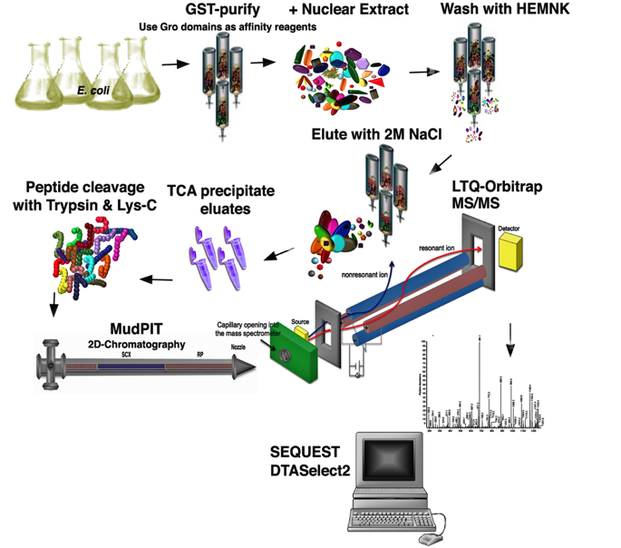
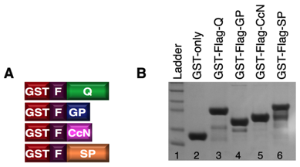
Schematic of the methodology used for MudPIT

Slide 57
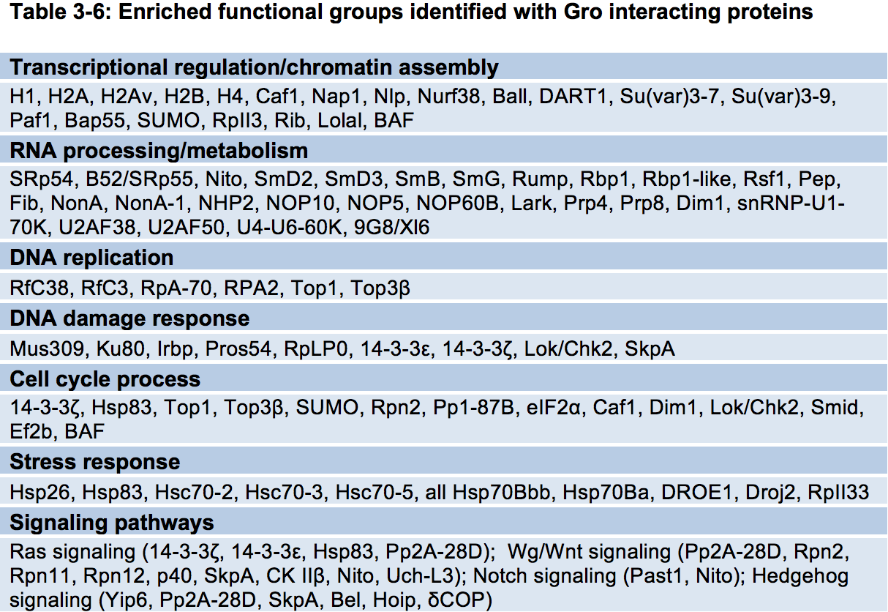
Enriched functional groups identified with Gro interacting proteins

Slide 58
Enriched functional groups identified with Gro interacting proteins

Slide 59
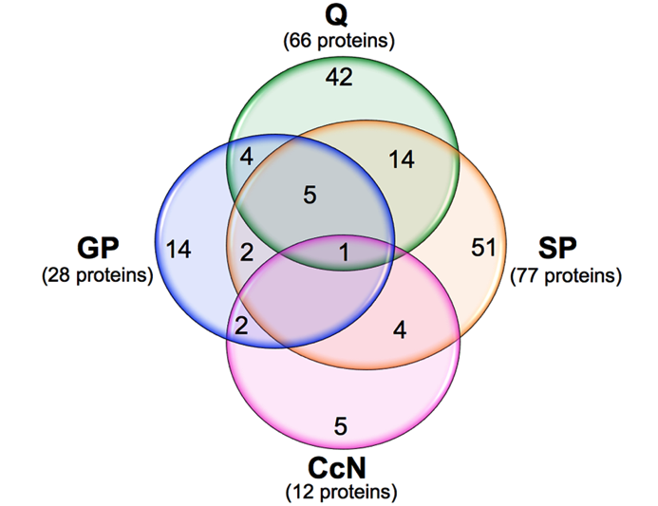
Overlap between the protein sets interacting with the individual Gro domains
142 proteins identified
110 interact with a single Gro domain, while 32 interact with two or more domains
Notes:
provided a large data set of possible Gro interacting proteins in the Drosophila embryo. Although much work remains to be done to validate these interactions and demonstrate their biological relevance, the fact that the list of proteins includes a number of previously validated interactors and the fact that the large majority of the proteins interact specifically with a single Gro domain, suggests that many of these interactions are functionally relevant. Further genetic analysis of these targets will be essential in elucidating the mechanistic requirements underlying Gro-mediated repression. The finding that the Gro central domains engage in such a diverse array of interactions is consistent with the notion that the central region may be a regulatory hub and may account for Gro’s position as the “champion corepressor”.

Slide 60
Factors identified to interact with Gro
Histone interactions
H2A, H2B, H4, H1, H2Av
Interactions with proteins that modulate chromatin structure
Caf1, Nap1, S(var)3-9, Ball/Nhk1, Ben/Ubc13, Pp2A
Interaction with RNA polymerase II
RNA polymerase II 33kD subunit (RpII33)
Factors that mediate posttranslational modification of Gro
CKII, CaMKII, PRMT1
Notes:
Gro interacts with several factors that catalyze the covalent modification of chromatin. These include the histone H3 Lys9 methyltransferase Su(var)3-9 and its partner Su(var)3-7. This raises the intriguing possibility that Gro might direct transcriptional silencing by directing the formation of the H3K9 methyl mark, a mark associated with heterochromatic silencing (Ebert et al, 2006; Hublitz et al, 2009; Schotta et al, 2002). Although both Gro-mediated silencing and heterochromatic silencing are long-range phenomena, Gro mediated silencing is much more readily reversible than heterochromatic silencing, which is an epigenetically stable state. So it will be interesting to see if this same chromosomal mark is associated with both types of repression. Other histone modifying enzymes with which Gro interacts are the Ben/Ubc13 H2Av Lys119 ubiquitylating enzyme (Ikura et al, 2007), the H2A Thr119 kinase Ball/Nhk1, and the H3 Ser10 phosphatase Pp2A (Nowak et al, 2003). Thus, Gro may be at the heart of many key events in chromatin biology

Slide 61
Conclusion: a new picture of Gro
Binding to hypoacetylated histone tails
Rpd3 binding
NLS
Down-regulation region
Repressor binding
Self-association
Repressor binding
Nuclear localization
(i.e Ran)
Higher ordered nucleosome assembly
(i.e Caf1, Nap1, H1)?
Morphogen gradient interpretation
S(var)3-9
binding?
Regulation of alternative mRNA splicing
(10 proteins)?
Despite being not well conserved, immutable, and probably disordered, the central domains of Gro are essential for function
Notes:
Despite being poorly conserved, immutable, and probably disordered, the central domains of Gro are essential for function

Slide 62
Acknowledgements
Courey Lab
Albert Courey***
Joseph Cao
Mike Chambers
Jesse Cheung
Pak Kwong**
Alberto Ponce**
Matt Smith
Martha Rivas
Ana Mariscal
Past Members
Minghua Nie**
Girish Ratnaparkhi*
Dennis Kuo
Clint Winkler
Wohlschlegel Lab
James Wohlschlegal
Ajay Vashisht
Tontonoz Lab
Peter Tontonoz
Claudio Villanueva
Committee Members
Steven Clarke
David Krantz
Frank Laski
Stephen Smale
Non Committee Members
Sabeeha Merchant
Mike Carey
MBIDP
Gail Panatier
Sue Ellen Parsee
Funding
UCLA Eugene V. Cota-Robles Fellowship
NIH National Research Service Award (NRSA) Training Fellowship
!!!
Gracias
!!!
Science Sisters
Nicole Rodriguez
Shilpi Khare
Claudia Gonzalez
Patricia Solorio
Kristine Molina
Family
Mom
Mirvette
Fatinah
Ihab
Hiba
Dea
Rakan
Isabella
Ayah
All of you for listening!!

